Slide 1

Clarusway Group Mentoring
(Week 2)

Slide 2
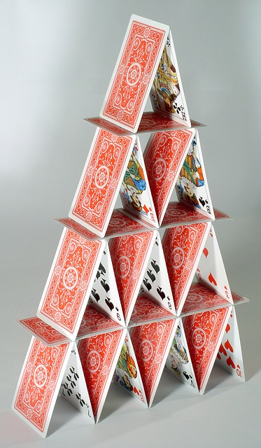



Floor | Base | Roof | Total
1 | 0 | 2 | 2
2 | 1 | 6 | 7
3 | 3 | 12 | 15
4 | 6 | 20 | 26
5 | 10 | 30 | 40
1
2
F: Floor B: Base R: Roof T:Total
B =
3
R =
T = B + R =
4

Slide 3
Floor | Base | Roof | Total
1 | 0 | 2 | 2
2 | 1 | 6 | 7
3 | 3 | 12 | 15
4 | 6 | 20 | 26
5 | 10 | 30 | 40
1
2
F: Floor B: Base R: Roof T:Total
Pseudocode-1
f = INPUT “Enter floor count”
CALCULATE b = f X (f-1)/2
CALCULATE r = f X (f+1)
CALCULATE t = b + r
PRINT “Cards needed for ” f “is:”
PRINT b “pieces for Base”
PRINT r “pieces for Roofs”
PRINT t “pieces total”
3
4
Notes:
Python notebook code

Slide 4
Pseudocode-2
SET card_limit = 104 # 2x52 pieces
SET f = 1
SET t = 0
WHILE t <= card_limit
BEGIN
b = f X (f-1)/2
r = f X (f+1)
t = b + r
f = f + 1
END
fm = f – 1
used_cards = (3*fm*fm + fm)/2
remaining_cards = card_limit – used_cards
PRINT “Using ” card_limit “cards”
PRINT “Maximum floor is ” fm
PRINT “Needed card count is” used_cards
PRINT remaining_cards “cards will remain”
1
2
3
4

Slide 5
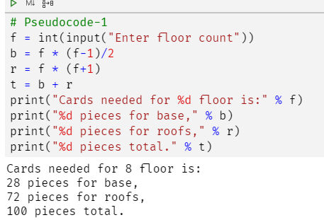
# Pseudocode-1
f = int(input("Enter floor count"))
b = f * (f-1)/2
r = f * (f+1)
t = b + r
print("Cards needed for %d floor is:" % f)
print("%d pieces for base," % b)
print("%d pieces for roofs," % r)
print("%d pieces total." % t)

Slide 6
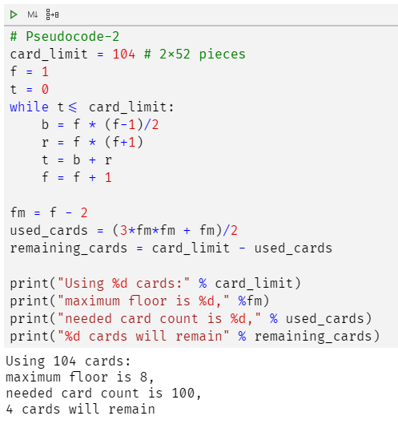
# Pseudocode-2
card_limit = 104 # 2x52 pieces
f = 1
t = 0
while t<= card_limit:
b = f * (f-1)/2
r = f * (f+1)
t = b + r
f = f + 1
fm = f - 2
used_cards = (3*fm*fm + fm)/2
remaining_cards = card_limit - used_cards
print("Using %d cards:" % card_limit)
print("maximum floor is %d," %fm)
print("needed card count is %d," % used_cards)
print("%d cards will remain" % remaining_cards)

Slide 7
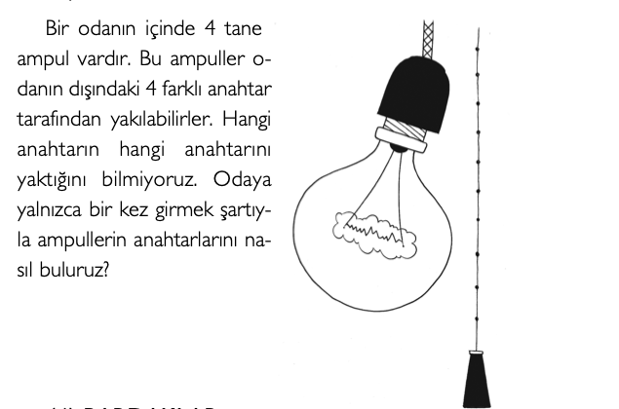
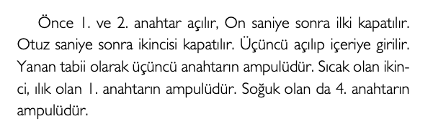
QUESTIONS
Warm up Questions:)

Slide 8
QUESTIONS
Scrum rolleri nelerdir? Kısaca açıklayınız
Cevap: Product Owner; is the business representative in the team and speaks for the needs
Scrum Master; a. Coachs the team, protects the team from organizational distractions
b. Helps team members focus on what they do
c. has an enabling role in a scrum team
Development Team; a. The team who works on project (Developer (Frontend-Backend), Tester, Data Analysist etc)
b. There is a project manager to lead them
c.Disiplin and integrity are the key terms for successful team
Epik nedir ? Örnek veriniz?
Cevap: a. An epic refers to a set of jobs that cannot be easily achieved in a single sprint
b. İt can be take months to perform an epic
c. They must be divided into multiple user stories before being worked on
Example: As a web site, we want to extra security precaution as authentication system on mobile phone

Slide 9
QUESTIONS
3. Scrum’da geçen ceremoniler(meetingler) nelerdir? Kısaca açıklayınız
Cevap: Sprint Planning; a. takes place at the start of each sprint and all the scrum roles take part in this meeting
b. The scrum team decides the scope and goals of the sprint
c. The product owner presents to the team the prioritized list of the user stories from the product backlog
selected stories constitute the sprint backlog
Grooming Meeting; a. is held to review the backlog and to ensure the backlog contains the appropriate items
b. The product owner, scrum master and some or all the development team participate in it
Daily Standup Meeting; a. is an internal meeting for the development team
b. The members of development team explain; what they complete yesterday, what will focus on today, What are the things impending them
c.it lasts maximum 15 mins
Sprint Retrospective; Like sprint review meetings this meeting is also held at the end of each sprint. The attendees of this meeting are the development team, the scrum master and the product owner. In this meeting, all the participants discuss: What went well in the previous sprint? What didn’t work well? What are the improvement areas to increase team performance?
4. Product Backlog nedir?
Cevap: The product backlog refers to the list of everything that needs to be done to complete the project.
The product owner fulfills the responsibility by creating the product backlog, prioritizing the requiriments in the product backlog list and constantly updating the list

Slide 10
QUESTIONS
5. What is the parts of the Compuational Thinking? Please explain briefly.
Cevap: ; Pillars of Computational Thinking
Computational Thinking is made up of four parts:
Decomposition: Breaking down data, processes, or problems into smaller, manageable parts
Pattern Recognition: Observing patterns, trends, and regularities in data
Abstraction: Focusing on important parts only, ignoring irrelevant details
Algorithm Design: Developing the step by step instructions for solving this and similar problems

Slide 11
QUESTIONS
6. Server nedir? Server tipleri nelerdir? Kısaca açıklayınız
Cevap: ; Server: Servers are computers that provide data to other computers
Web Server: Every website works on servers. They host websites; such as Apache or Microsoft IIS(Internet Information Service They also hold web documents and makes them available for viewing by remote browsers
Mail Servers: is aserver that handles and makes them available for viewing by remote browsers
SMTP: When you press the ‘sent button in your email app, the program will connect to a server on the network / Internet that is called an SMTP (Simple Mail Transfer Protocol)
POP3: When you download e-mails to your mail program the program will connect to a server on the network / Internet that is known as a POP3 (Post Office Protocol version 3) server.(Post Office Protocol version 3)
IMAP: (Internet Message Access Protocol) is a method of accessing and storing mail on a mail server. IMAP allows you to access your email wherever you are, from any device. When you read an email message using IMAP, you aren't actually downloading or storing it on your computer; instead, you're reading it from the email service.
File Server: A file server (or fileserver) is a computer attached to a network that provides a location for shared disk access, i.e. storage of computer files (such as text, image, sound, video) that can be accessed by the workstations that are able to reach the computer that shares the access through a computer network.

